Slide 1
Business understanding and objectives
Google play is an official app store for the Android operating system.
It’s developed and operated by Google. Besides applications it also serves as a digital media store, offering music, books, movies and television programs.
Google play’s main competitor is the Apple store. To maximize the profit and beat the competitors (Apple store), the company has to perform an analysis of the apps that they offer.
Business goals:
Increase the number of sold applications free and non free.
Increase the revenue of in-app ads (has to be checked in the next project)
Business success criteria:
Increase the applications sales by 10%.
Increase the revenue from in-app ads by 10% (future project)

Slide 2
Assess situation
Inventory of Resources:
Data analysts, Data collectors, Statisticians.
Sales data with the information on available applications and customers.
Risks and Contingencies:
Time limitation.
Costs and benefits:
1. This project is free of cost.
2. If business goals are reached then the sales will be increased.
Terminology: See appendix A

Slide 3
Data mining goals
Data mining goals:
Identify the most popular App Category.
Data mining prediction:
Create a model that can be used to predict the number of installations
given the size, reviews and category.
Data mining success criteria:
Provide enough analytical information to increase the sales of the applications and in-app adds.
Enable Google play team of developers to make data-driven decisions with respect to the kind of apps they build.
Model accuracy will be set for 70%

Slide 4
Project plan
Phases | Time frame
Business understanding | 10/20-10/26/19
Data understanding | 10/27-11/2/19
Data preparation | 11/3/19-11/9/19
Modeling | 11/10/19-11/16/19
Evaluation | 11/17-11/23/19
Deployment | 11/24-11/30/19
Resources are needed for all phases:
1.Computer, kaggle.com (data that is used for the
Project), Azure Data studio, R studio.
2. Junior data analyst ( Mrs. Karpenkova), Senior data analyst (OSU professor) as needed
Risks:
1. Change in economy, technical issues.
2. Difficulties with modeling.

Slide 5
Data Understanding
Initial Data Collection Report:
As of September 2018, there are approximately 2.1 million Android apps on Google Play.
In order for us to save some time and money, we will be analyzing a sample of data that is taken from the Google Play Store and it’s available on
www.kaggle.com/lava18/google-play-store-apps#googleplaystore.csv
googleplaystore.csv has the following information:
application name, category the app belongs to, overall user rating, number of user reviews for the app, size of the app, number of user downloads/installs, type (paid/free), price of the app, age group the app is targeted at, genres, last update (2015-2018), current version of the app available on Play Store, minimum required Android version.

Slide 6
Data Understanding
Data Description:
googleplaystore.csv has 18 columns and 10842 rows. It contains numbers, symbols, and foreign language inputs.
We are going to review the following relationships:
free vs paid apps; the most popular category;
number of installs vs category.
It will help us to determine the best sales options for the customers.
This dataset doesn’t contain the information on DOB and income, that could be useful for the data modeling.
Our initial pattern detection includes a review of the data file in Excel with the verification of the column, unique values, and number of perceived “error values”.

Slide 7
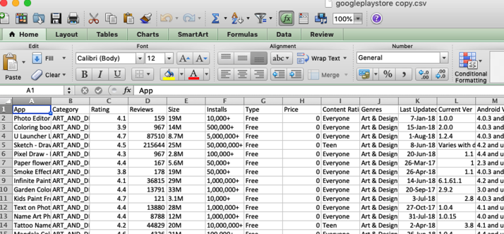
Data Understanding
Quality Issues:
After a quick glance at the data, we found the following issues:
Inaccurate data that needs to be corrected or removed
Duplicate data, that needs to be removed
(we are keeping the duplicates with the highest number of reviews )
- Non-English apps and symbols that needs to be removed
(our project targets an English-speaking audience.)
Punctuation marks (., !, ?, ;) and other symbols (+,*, /, $) needs to be removed.
(keep these symbols for the apps names)

Slide 8
Data Preparation using SQL
For this project I used Azure Data Studio
Removing ‘Genres’ column and keeping ‘Category’ column
Changing the Size of the apps into Mb, and
removing Mb, leaving just a number.
Making sure that ‘price’ column is matching ‘type’ column
(‘price’=‘0’ and ‘type’=‘Free’)
Making sure that all apps have reviews in a range 0-5 (row #10472)
The number of installs needs to change from open ended to precise
(100+, 1000+ into 100, 1000, etc.)
Removing ‘Current Version’, ‘Android Version’ columns.
Removing duplicate apps
Removing ‘ , ‘
See the Appendix B for the SQL code

Slide 9
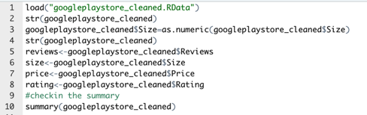
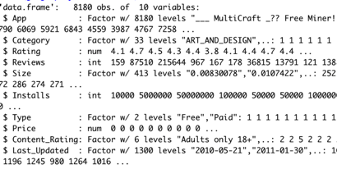
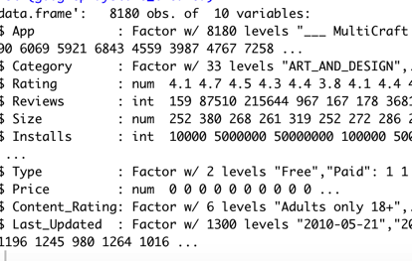
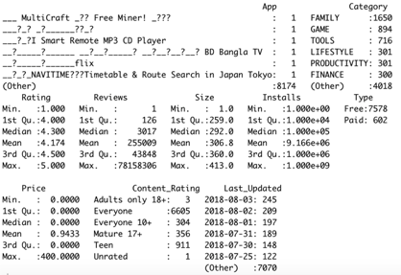
Data Analysis: checking the data
The most popular category: Family and Other
Price range is form 0 to 400, with the median = 0
There are 7578 free apps and 602 paid apps in the data
Changing “size” from factor to number

Slide 10
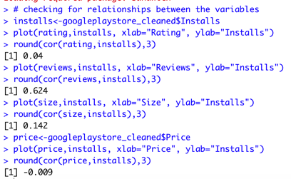
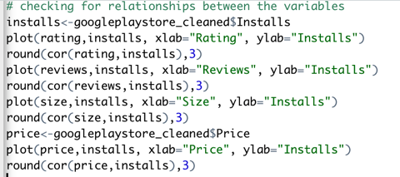
Checking for relationships between the variables
It looks like there is a weak positive relationship between the number of installations
and rating, and installations and size.
Almost no correlation between the number of installations and price.
Moderate positive relationship between the number of installations and reviews.

Slide 11
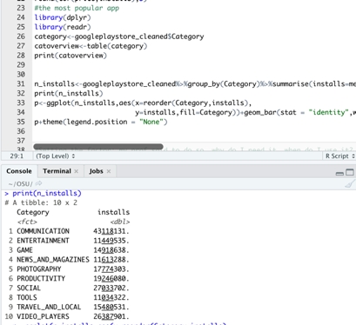
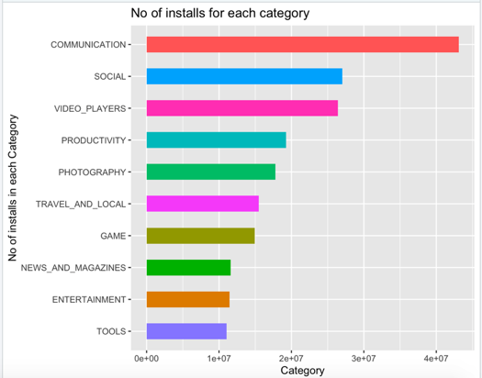
Checking for relationships between the variables
Now assuming that "More the Number of Installs , more popular the App is".
*Checking which category has the most number of installs
Not so shocking Results!!* Communication is the most popular category of Apps in Play Store, followed by Social and Video_players.

Slide 12
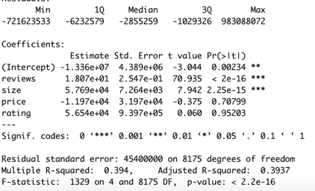
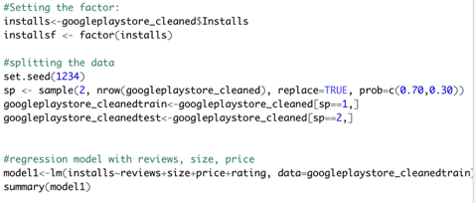
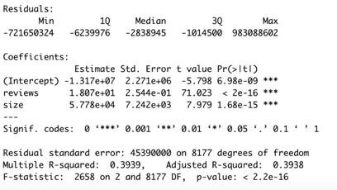
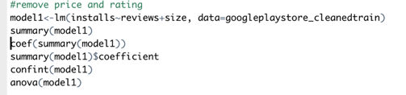
Linear regression: checking our first model with train data (quantitative variables)
Setting the factor, splitting the data
As we predicted earlier “price” and “rating” are not significant for this model
We will remove them from the model
Lower p-values indicates that model may have
some significance in determining a linear
relationship.
The area of concern: only 39 % of variance on the measure can be
predicted by size and reviews

Slide 13
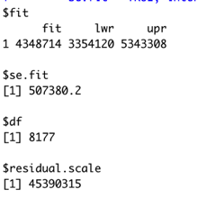
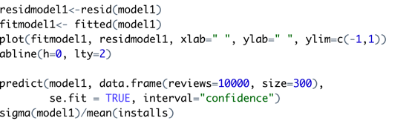

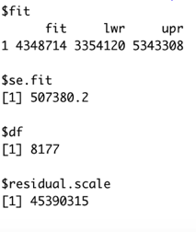
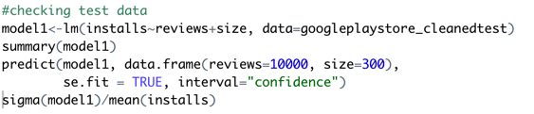
Linear regression: checking our first model with train data (quantitative variables)
Checking predictions:
For size = 300 and reviews =1000 we can expect to have
Between 3,354,120 and 5,343,308 downloads
Area of concern: high error rate
Checking the test data:

Slide 14
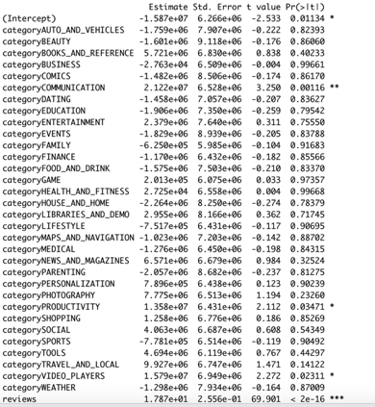


Linear regression: checking our second model with train data (quantitative+
qualitative variables)
Adding “category to our model”
The following category are significant: video_players**, social**,productivity*,communication***
Lower p-values indicates that model may have
some significance in determining a linear
relationship
The area of concern:
only 40 % of variance on the measure can be
predicted by this model

Slide 15
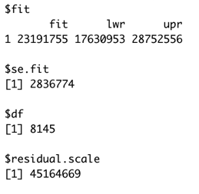
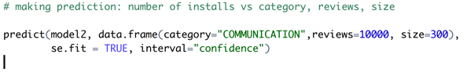
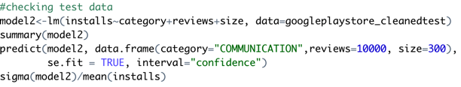
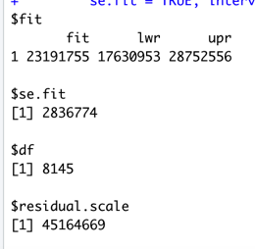
Linear regression: checking our first model with train data (quantitative variables)
Checking predictions:
For “Communication” with the size = 300 and
reviews =1000 we can expect to have
Between 17,630,953 and 28,752,556 downloads
Checking the test data:

Slide 16
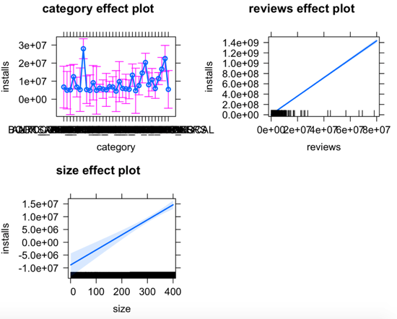

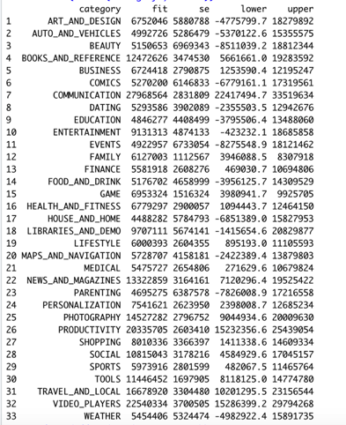
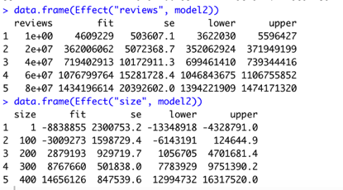

Slide 17
Assessment
The model suggests that there is a relationship between the number
of downloads and Communication category.
Both models under-predict the number of downloads.
Models are poorly fit with a high error rate.
- If data is going to be altered then the same models can be reused and
updated to find new associations

Slide 18
Deployment and Maintenance Plans
Overall conclusion is that the models are not deployable in current state
The following steps can be applied to improve the models:
Acquire raw data for detailed evaluation of independent variables.
Expand model scope of independent variables.
Remove the outliers from the data.
Train the junior data analyst: on fundamentals of processing of working in R.
Models’ updates to be completed weekly, due to the nature of the data.

Slide 19
Business Conclusions
Number of downloads has a relationship with the category, the size
and the number of reviews of the apps.
The most popular categories appear to be Communication, and Video_players.
Number of downloads has no relationship with the type of app (free/ not free).
Initial success criteria is too broad for the data.
Current success criteria is not 100% capable of being achieved.

Slide 20
Business Conclusions
Business goals may be achieved if the data gets expanded and processed again.
Moving forward I have a much better understanding of everything involved
in the data mining process.
My biggest shortcoming was seeing this process the first time and not understanding
the basics.
I should have found additional data or restate my goals for this project.

Slide 21
Appendix A
App – name of the Application
Category – category of the App
Rating – app rating on play store
Size – size of app in MB
Installs – number of downloads
Type – whether the app is paid or free
Price – price of the app if its not free
Content. Rating – age limitations for the app
Genres – subdivision of category
Last update – when was the app last updated

Slide 22
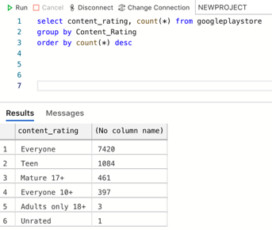
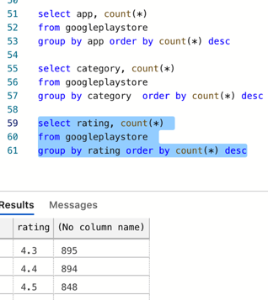
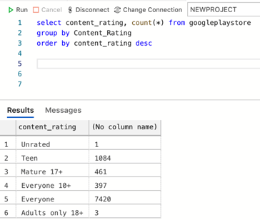
Appendix B
Checking the data

Slide 23
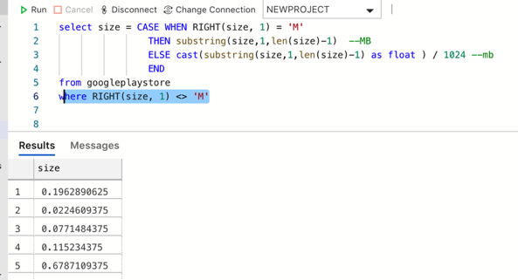
Changing App size to Mb, removing ‘+’, ‘, ’

Slide 24
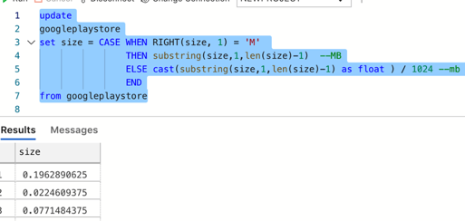
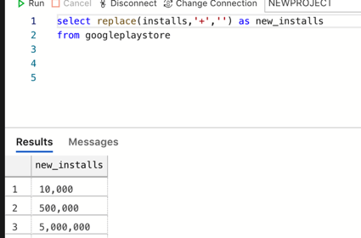
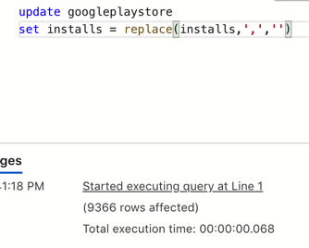

Slide 25
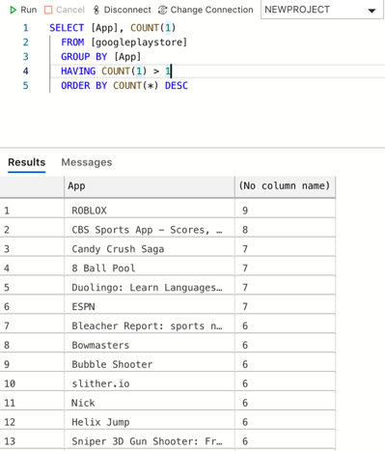
Removing duplicates

Slide 26
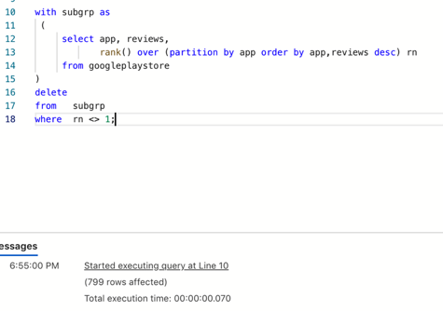
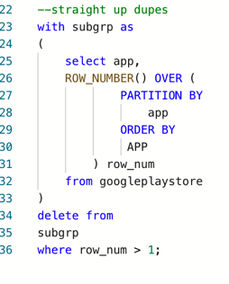

Slide 27
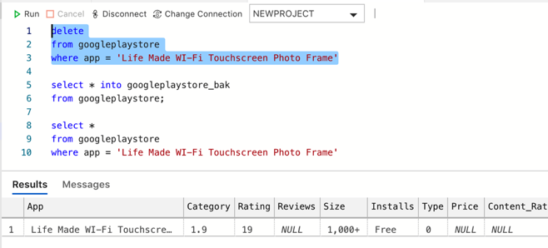
Removing rating >5

Slide 28
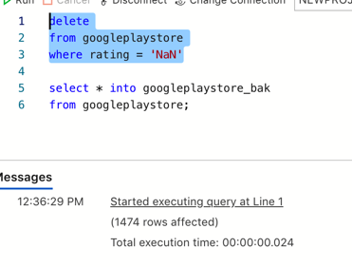
Deleting apps with no rating

Slide 29
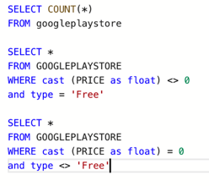
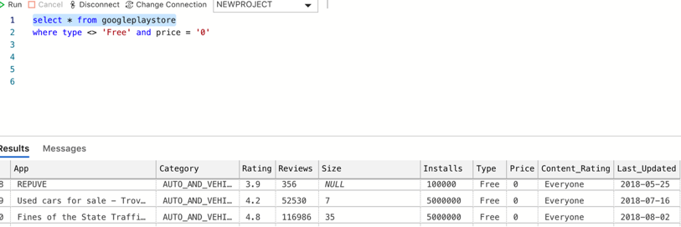
Checking if ‘price’=‘0’ and ‘type’=‘Free’ match

